Slide 1
What’s wrong with this data visualization?
Adapted for CGT 2700 Data Visualization
Group 13

Slide 2
Group 13
Group Members
Instructions
Rudra Patel
Memoria Hu
Scribe: Connor Colbert
Examine the visualization on the next slide
Determine what’s wrong with the visualization
Then, provide recommendations on how the group would REFINE the visualization
Use any of the resources mentioned in previous lectures and readings

Slide 3
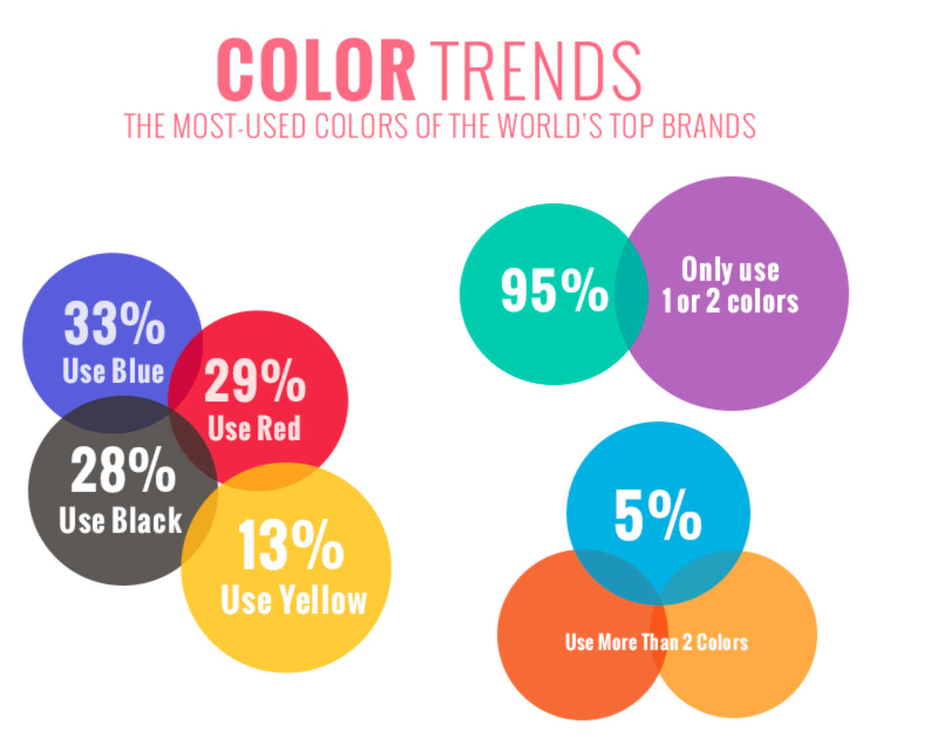

Slide 4
What is it?
This graphic was created by an agency called Blueberry Labs and shows the most common colors used by brands.

Slide 5
What’s wrong with it?
Color percentages add up to over 100%
Odd sizing of bubbles; don’t represent the value inside (e.g. 13% bubble is the largest)
1-2 vs 2+ color comparison feels disjointed
Colors take away from the meaning

Slide 6
What should they have done?
Use pie chart for color data
Or use bar graph if data is intended to exceed 100%
Use separate visualization for color quantity data
Unrelated to visualization subject
Add annotations

